Slide 1
Adaptation techniques of a city planning due to climate change
N. V. Bakaeva, M. O. Suvorova, R. A. Sheps, А. А. Kormina

Slide 2
Problem statement
The purpose of the article is to analyze the concepts of urban planning and innovative urban planning solutions in order to identify trends in the adaptation of the urban environment to climate change.
Four concepts in urban planning
"Sustainable city" is the basic trend of modern urban planning, which involves the preservation of environmental integrity and resource conservation in combination with the use of new technologies and various innovations.
“Adaptability of the spatial environment", implying the adaptation of the environment to changing external conditions. The concept defines new planning principles, new types of project tasks and means of their implementation, reforming adaptation methodologies.
The concept of biosphere compatibility of cities and settlements developing people. The concept determines that Nature is an absolute value, which is higher than a human.
“Smart city". It is a, first of all, urban planning concept of ensuring a high quality of life.

Slide 3
The concept of adaptive urban planning
the adaptability of the urban environment is considered as a fundamental basis for solving design problems to ensure comfortable and safe conditions for human life
Climate adaptation is aimed at improving environmental conditions and controlling the microclimate of the entire environment, considering the individual needs
the search for new forms of intra-environment interactions that regulate the parameters of the environment
development of means for transformation elements of the environment, from mobile design to transformable architectural objects

Slide 4
Climate-adaptive urban design
• control the amount of solar radiation reaching the public space by providing different gradients of sun and shade;
• use the influence of green spaces on thermal comfort in cities and human bioclimatic parameters;
• consider the effects of wind by providing wind protection in winter or by stimulating ventilation cooling in summer;
• regulate air temperature and relative humidity by combining parameters such as evaporation and aeration;
• optimize heat loss from surfaces by reflecting as much solar radiation as possible and releasing heat.
Main categories of spatial elements
green vegetation
shading devices
surface materials
aquatic resources

Slide 5
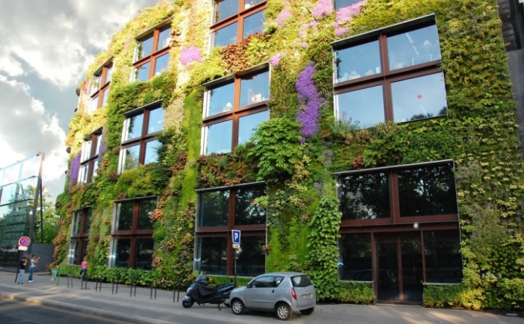
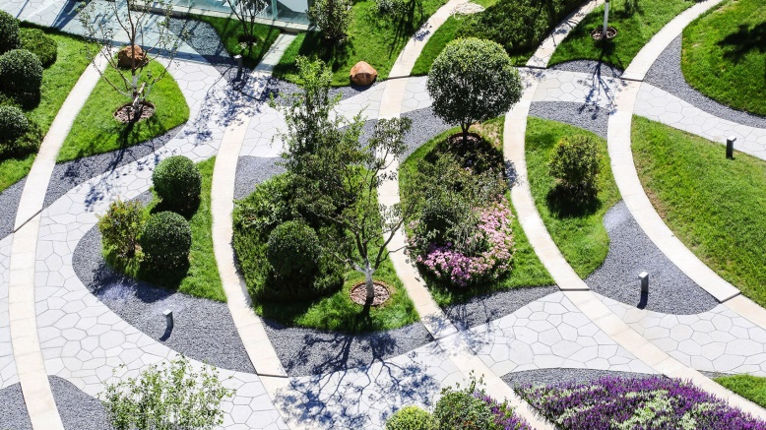
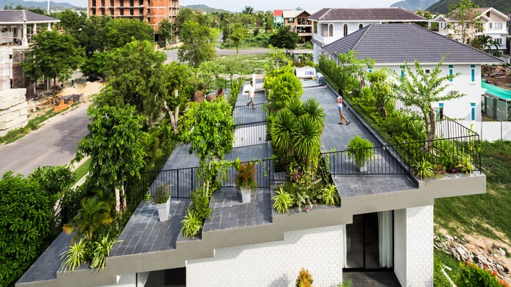
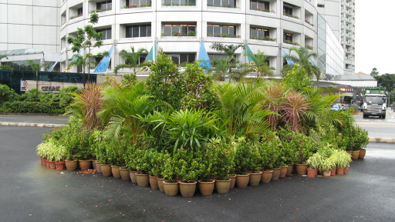
Vegetation as an element of urban design

Slide 6
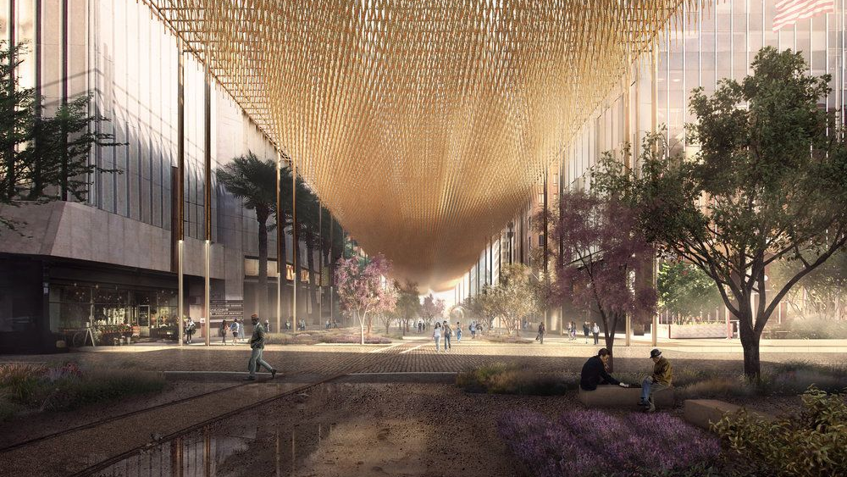
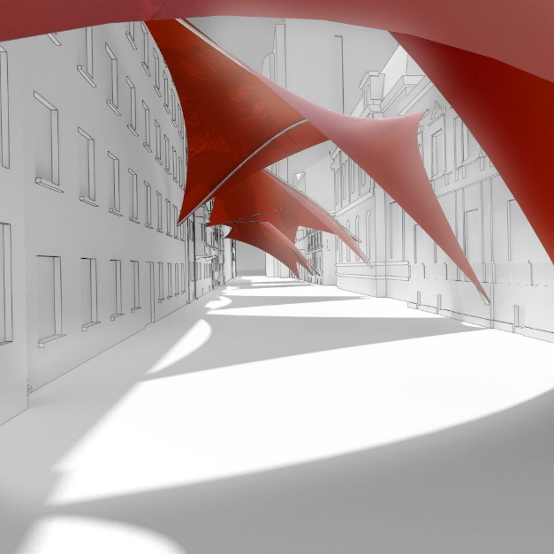
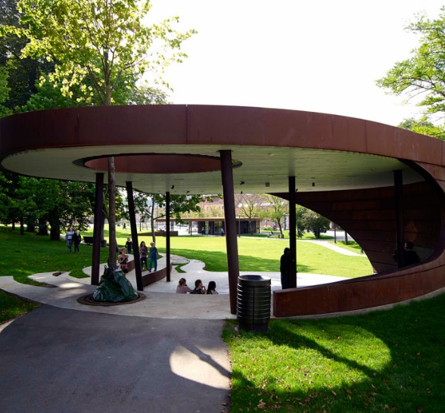
Artificial shading devices

Slide 7
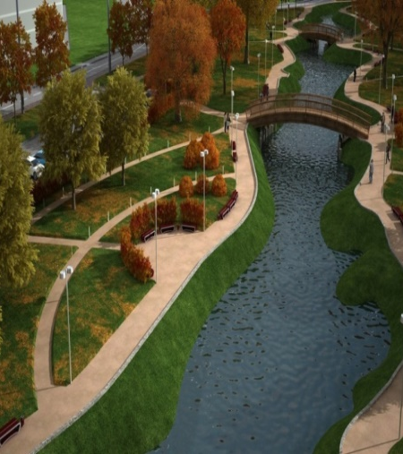
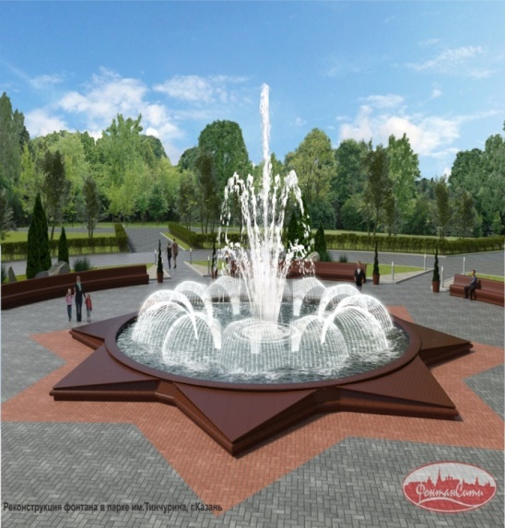
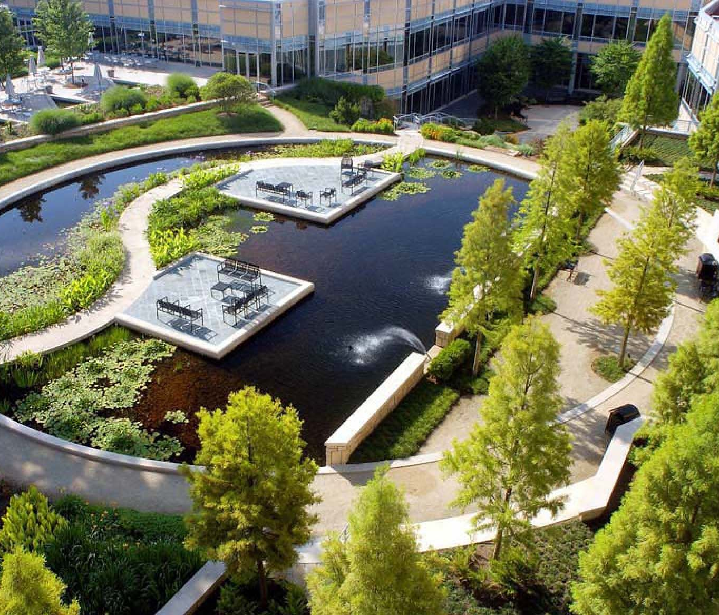
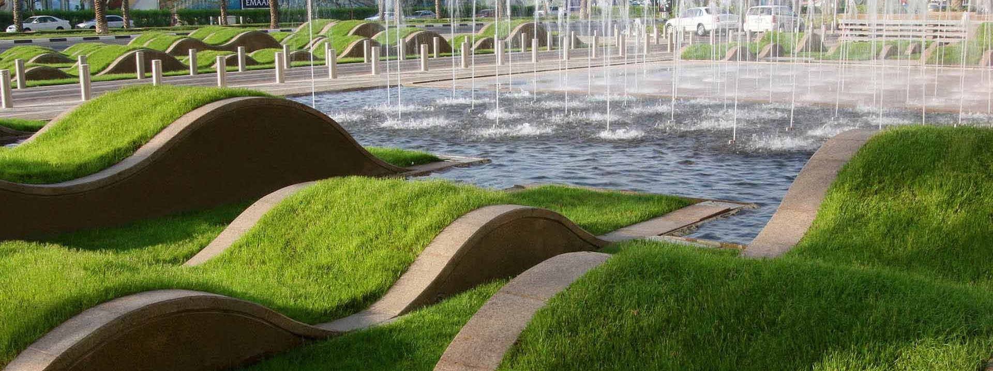
urban landscapes with natural and artificial water bodies

Slide 8
Conclusions
new urban planning concept of territorial planning considering climate change
legalize the concept of adaptive urban planning
New approaches to the development of principles for the formation of the urban environment
climate-adaptive design,
transformation of functionally existing types of public spaces,
the use of public low-carbon transport,
the introduction of smart city technologies

Slide 9
N. V. Bakaeva - natbak@mail.ru
M. O. Suvorova
R. A. Sheps
А. А. Kormina
This research was carried out under the project 620497-EPP-1-2020-1-RU-EPPJMO-MODULE “Climate change and urban planning: European experience” (CLEUX), funded with support from the European Commission. The findings and opinions reported in this paper reflect the views only of the authors, and the Commission cannot be held responsible for any use which may be made of the information contained in it.
Moscow, 2021

